Slide 1
Supplement Slides for Session 1 Consequences of e-cigarette use
Ontario laws and school policy in Ontario.
CATCH My Breath
Notes:
Suggested length: 35 minutes

Slide 2
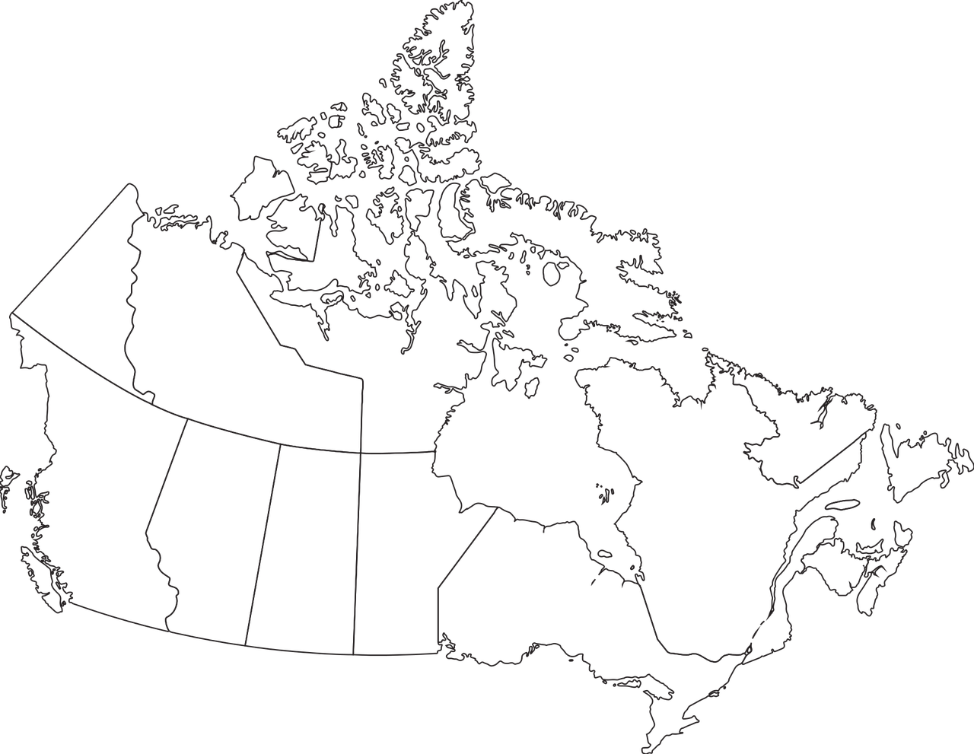
restrictions around the sale, purchase, or use of E-cigarettes or nicotine containers to a minor.
To learn more visit Canada.ca or Ontario.ca to find out the specific laws in your province.
Image by Craig Clark from Pixabay
Notes:
https://www.ontario.ca/laws/statute/17s26

Slide 3
Sacred Tobacco
Important to note is that Sacred Tobacco and Commercial Tobacco are two different things.
First Nations peoples have been using traditional or sacred tobacco for thousands of years. Traditional or sacred tobacco differs from commercial tobacco in that it is used in ceremonial or sacred rituals for healing and purifying.
It is grown and dried and so has no additives. First Nations elders teach that tobacco was one of the 4 sacred medicines (Tobacco, Cedar, Sage and Sweetgrass), which was given by the Creator to the first peoples of this land.
Source: https://tobaccowise.cancercareontario.ca/en/first-nations
Use of sacred tobacco in public places is allowed and is protected in the Smoke-Free Ontario Act, 2017. It is not banned in public places like smoking of commercial tobacco or vaping.
Notes:
Information from www.tobaccowise.ca https://tobaccowise.cancercareontario.ca/en/first-nations

Slide 4
Tobacco & Vaping Laws in Ontario
The legal age to purchase e-cigarettes or vapes, e-liquid and other vaping products in Ontario is 19.
It is not illegal for people under the age of 19 to have tobacco and vapour products in their possession (unless it contravenes school policies).

Slide 5
Supply or Share Products
Youth and adults can be fined for sharing or selling vapour products or tobacco products to youth under 19.
The fine is $490 for selling or supplying vapour products or tobacco products to someone under 19 years of age. (This includes sharing or giving vapes or e-liquids to someone under 19).

Slide 6
Where is smoking or vaping banned in Ontario?
Schools
Playgrounds and publicly owned sports areas
Restaurant and bar patios
Vehicles and boats
Child care facilities
Reserved outdoor seating venues
Community recreational facilities
Enclosed workplaces (including workplace vehicles like school buses
Enclosed public places
Government office buildings
Sheltered areas (bus shelters)
Hospitals and other health care facilities
Residential care facilities
Common indoor areas of Multi-unit residences (unless it is a designated for smoking and/or vaping.)
Hotels, motels and inns
Notes:
Learn where smoking tobacco or cannabis or vaping anything (e.g. with an e-cigarette) is banned in Ontario. https://www.ontario.ca/page/where-you-cant-smoke-or-vape-ontario#section-10

Slide 7
School property
No person can smoke or vape on school property or within 20 metres of school property
The fine for vaping or smoking on school property is $305
Notes:
No person can smoke or vape on school property or within 20 metres of school property
The fine for vaping or smoking on school property is $305 (including fees).
https://www.publichealthgreybruce.on.ca/Portals/0/Topics/SmokingTobacco/SFOA_Schools.pdf

Slide 8
In School Buses
It is against the law in Ontario to smoke or vape in a workplace vehicle.
The fine in 2019 for vaping or smoking in a workplace is $305 (including fees).

Slide 9
In Vehicles with Children
It also is against the law to vape or smoke in a motor vehicle with someone less than 16 years of age in the vehicle.
Notes:
https://www.publichealthgreybruce.on.ca/Portals/0/Topics/SmokingTobacco/SFOA_Motor_Vehicles.pdf

Slide 10

School Policy
What does your school policy say?
School board policies list rules about substance use, tobacco and vapour products and what steps will be taken if used on school property or during school activities.
Principals and teachers and other school staff can enforce these policies and confiscate products, issue suspensions and report issues to Tobacco Enforcement officers. These officers can issue tickets under the Smoke-free Ontario Act, 2017.
Notes:
In addition to the laws and regulations of the Smoke-Free Ontario Act 2017, school boards have policies that outline rules and discipline for substance misuse on school property or at school sanctioned events. Visit your policy here or speak with your school administration. Below are example polices from the Grey Bruce Region:
Blue Water District School Board
Refer to this section of policies: www.bwdsb.on.ca/director/Policies_Procedures_Index
Alcohol, Tobacco, Vaping, Cannabis, and Drug Free Environment http://www.bwdsb.on.ca/director/Procedures/AP_3810-D.pdf
Drug, Cannabis, Alcohol, and Tobacco - Standards and Education http://www.bwdsb.on.ca/director/Procedures/AP_6806-D.pdf
Bruce Grey Catholic District School Board, refer to: http://www.bgcdsb.org/UserFiles/Servers/Server_5912063/File/Policies%20under%20review/2018%202019/BP%206-28%20Smoke%20&%20Slcohol-Free%20Environment.pdf
Student Transportation Service Consortium of Grey-Bruce
http://www.bwdsb.on.ca/director/Procedures/TCP-B005.pdf

